Slide 1
April 10, 2022 Warfield Blvd

Slide 3
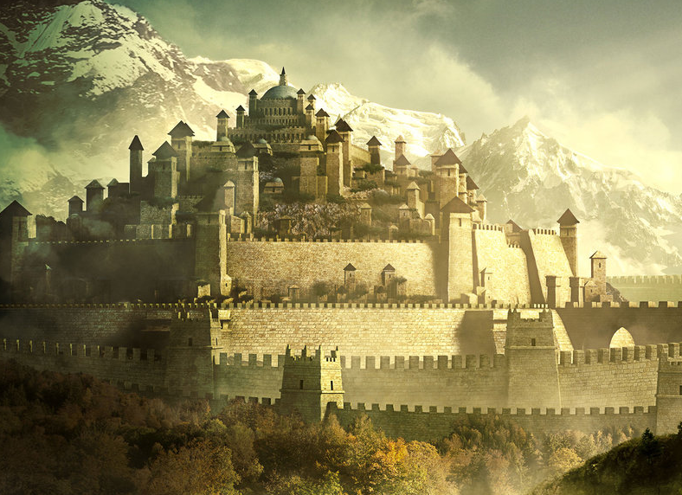
Thy Kingdom Come

Slide 4
Matthew 6:9-10
“After this manner therefore pray ye: Our Father which art in heaven, Hallowed be thy name. Thy kingdom come, Thy will be done in earth, as it is in heaven.”

Slide 5
Kingdom Needs An Origin
Dan 2:39-45 A Kingdom forever
Dan 7:13-14 Dominion and Glory
Matt 16:18-19 I will build My church
Matt 16:28 Some will see kingdom
Mark 9:1 Kingdom with power
Acts 2 Right time, right place

Slide 6
Kingdom Needs A King
2 Sam 7:12-13 Throne prophesied
Luke 1:32-33 Throne given by God
John 18:37 Rightly say that I am
Heb 1:3, 8 Your throne is forever
Heb 8:1-2 Right hand of God
Rev 19:6 King of Kings

Slide 7
Kingdom Needs Law
Jer 31:31-34 Covenant prophesied
Jer 32:38-40 Covenant everlasting
Col 2:13-15 Old is nailed to cross
Heb 8:6-13 New covenant fulfilled
John 14:23 Keep word to have home

Slide 8
Kingdom Needs Leadership
Eph 4:11-12 Christ appointed
Acts 20:28 Elders
1 Tim 3:8-13 Deacons
Rom 10:14-18 Preachers
Heb 13:7, 17 Submissive

Slide 9
Kingdom Needs Subjects
John 15:7-10 You will be my disciples
Rev 1:6 We are the kingdom
Rom 16:16 The churches of Christ
Acts 2:47 Added to the church
Heb 10:24-26 Assemble and exhort
Col 1:13, 18 Church, body....

Slide 10
Colossians 1:13
"He has delivered us from the power of darkness and conveyed us into the kingdom of the Son of His love,"
Colossians 1:18
"And He is the head of the body, the church, who is the beginning, the firstborn from the dead, that in all things He may have the preeminence."

Slide 11
Are you a subject in the kingdom?

